Slide 1
Strategy Pattern

Slide 2
Strategy Pattern: Introduction
Lets a family of algorithms to be used interchangeably by a client.
Non-software example: Transportation to airport.
Several options exist:
  Drive own car, take a taxi, or an airport shuttle.
  New modes such as subways and helicopters can become available later.
  A traveler can chose a Strategy based on tradeoffs between cost, convenience, and time.

Slide 3
Strategy Pattern
Helps manage several different implementations:
  Of what is, conceptually, the same functionality.
A strategy is an algorithm represented as an object.

Slide 4
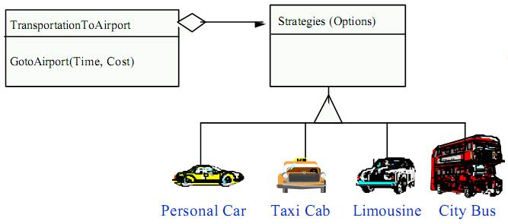
Non software example
Strategy defines a set of algorithms that can be used interchangeably.

Slide 5
The Strategy Pattern: Intent
Define a family of algorithms:
  Encapsulate each one, and make them interchangeable.
Strategy lets the algorithm vary independently from clients that use it.

Slide 6
Strategy Pattern: Structure
Client
Context
Strategy s;
setStrategy()
ContextInterface()
Strategy
AlgorithmInterface
ConcreteStrategyA
AlgorithmInterface()
ConcreteStrategyB
AlgorithmInterface()
ConcreteStrategyC
AlgorithmInterface()
Policy decides which Strategy is best given the current Context

Slide 7
Context Class
Context:
  Clients interact with the Context, not Strategy
  Context uses strategy

Slide 8
Advantages of Strategy
Can define a family of algorithm in one place
Can make a class hierarchy of algorithms
Easy to replace one algorithm with another
Can change dynamically
Can encapsulate private data of algorithm

Slide 9
Simple Example: Temperature Converter
A temperature sensor generates temperature reading in Kelvin.
Two displays are required
  One in Celsius
  Other in Fahrenheit

Slide 10
Simple Example: Solution
KelvinConverter
+executeConverter
(temp:Kelvin)
<<interface>>
TemperatureConverter
-tempConvert:
TemperatureConvert
+convertTemperature
(temp:Kelvin)
ConcreteStrategyCelsius
ConcreteStrategyFahrenheit
+convertTemperature
(temp:Kelvin)
+convertTemperature
(temp:Kelvin)

Slide 11
class KelvinConverter {
private TemperatureConverter tempConverter;
public KelvinConverter(
TemperatureConverter tempConverter) {
this.tempConverter = tempConverter;
}
public double executeConverter(double temp) {
return tempConverter.convertTemperature(temp);
}
}
interface TemperatureConverter {
double ConvertTemperature(double temp);
}

Slide 12
class ConcreteStrategyCelsius implements
TemperatureConverter {
public double convertTemperature(double temp) {
return temp - 273.15;
}
}
class ConcreteStrategyFahrenheit
implements TemperatureConverter {
public double convertTemperature(double temp) {
return ((temp - 273) * 1.8 ) + 32;
}
}

Slide 13
public StrategyTest(){
KelvinConverter kelConvert;
double testTemp = 273.00;
kelConvert = new KelvinConverter(new ConcreteStrategyCelsius());
double celsiusResult = kelConvert.executeConverter(testTemp);
System.out.println(celsiusResult);
kelConvert = new KelvinConverter(new ConcreteStrategyFahrenheit());
double fahrenheitResult = kelConvert.executeConverter(testTemp);
System.out.println(fahrenheitResult);
}
public static void main(String[] args) {
new StrategyTest();
}

Slide 14
Strategy Pattern: Exercise 1
You have an array of items:
  At run-time you want to decide which sorting algorithm to use.
  Bubble sort, quick sort, or merge sort
Solution:
  Encapsulate each different sorting algorithm using the strategy pattern.

Slide 15
DataArray
Search()
Sort()
Strategy
Sort()
Strategy
BubbleSort
Sort()
QuickSort
Sort()
MergeSort
Sort()

Slide 16
Exercise 2
Many different layout strategies exist.
  Flow layout, Border layout, card layout
  A GUI container wants to decide at run-time which layout to use
Encapsulate each different layout algorithm using the strategy pattern.

Slide 17

Explanation: GUI components and containers
textfield component
3 button components
label
component
frame container
with 5 components (textfield, 3 buttons, label)

Slide 18
Layout Managers
User interfaces made up of components
Components placed in containers
Container needs to arrange components
Swing doesn't use hard-coded pixel coordinates
Advantages:
  Can switch "look and feel"
  Can internationalize strings
Layout manager controls arrangement

Slide 19
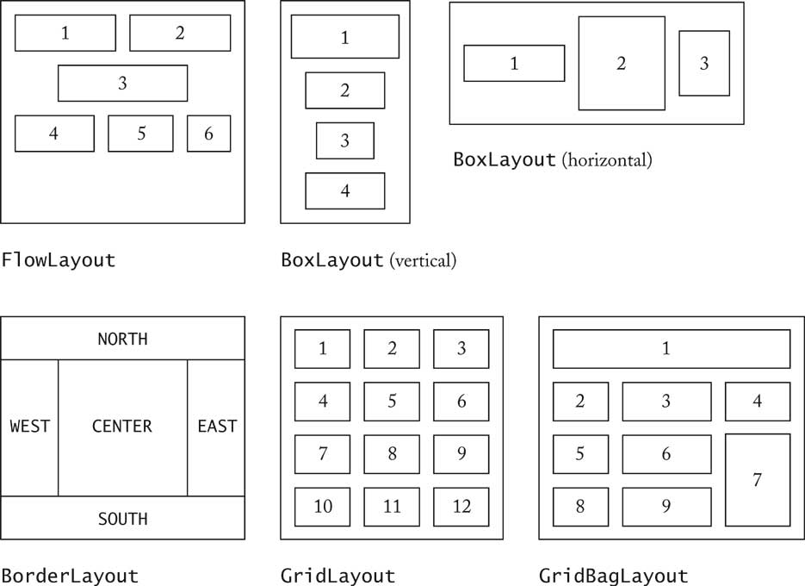
Layout Manager: Options

Slide 20
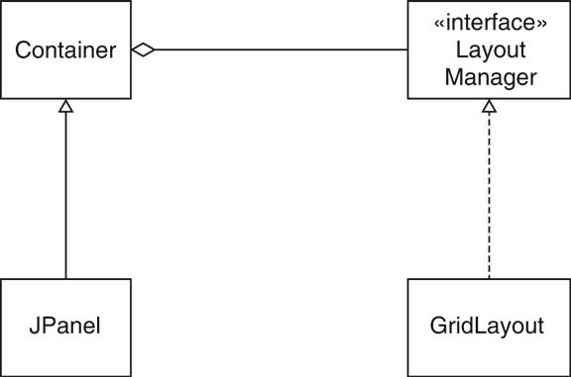
Layout Managers

Slide 21
Container
LayoutMgr
Sort()
Strategy
FlowLayout
BorderLayout
CardLayout

Slide 22
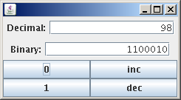
Example
JPanel decDisplay = new JPanel();
final JTextField digits = new JTextField(“98",15);
decDisplay.add(new JLabel("Decimal:"));
decDisplay.add(digits);
JPanel Default :
FlowLayout
JPanel display = new JPanel();
display.setLayout(new BorderLayout());
display.add(decDisplay, BorderLayout.NORTH);
display.add(binDisplay, BorderLayout.SOUTH);
BorderLayout

Slide 23
Example
JPanel keyboard = new JPanel();
keyboard.setLayout(new GridLayout(2,2));
keyboard.add(new JButton("0"));
keyboard.add(new JButton("inc"));
keyboard.add(new JButton("1"));
keyboard.add(new JButton("dec"));
GridLayout
JFrame Default :
BorderLayout
JFrame f = new JFrame();
f.add(display,BorderLayout.NORTH);
f.add(keyboard,BorderLayout.CENTER);

Slide 24
Applicability
Use when many different algorithms exist for essentially the same task.
Some Examples:
  Breaking a stream of text into lines
  Parsing a set of tokens into an abstract syntax tree
  Sorting a list of customers
Different algorithms will be appropriate in different situations
  We don’t want to support all the algorithms if we don’t need them
If we need a new algorithm, we want to add it easily without disturbing the application using the algorithm

Slide 25

Exercise 3:
Intersection Traffic Lights Control
The light- switching policy changes by the hour

Slide 26
Traffic Light Behavior Varies
The “dumb” policy:
  Change the green route every 5 seconds
Midnight policy:
  Change to green whenever a “sensor” detects a vehicle
Rush hour policy:
  Double the “green time” in the busy route

Slide 27
Traffic Lights Management
Intersection
Policy
LightsPolicy
NextEvent()
ChangeEvent(LightsPolicy)
CycleSize()
NightTraffic
RushHour
DayTime
Cycle()
Cycle()
Cycle()
Emergency
Cycle()

Slide 28
Sequence Diagram
current_policy:
rush_hour
current_policy:
Night traffic
:Intersection
cycleSize()
changePolicy ( )
3: cycleSize()

Slide 29
Strategy: Consequences
Easy to add new strategy or remove an existing one,
For instance: New policy
From 8 a.m. to 10 a.m. there is no turn left from A onto B
B
A

Slide 30
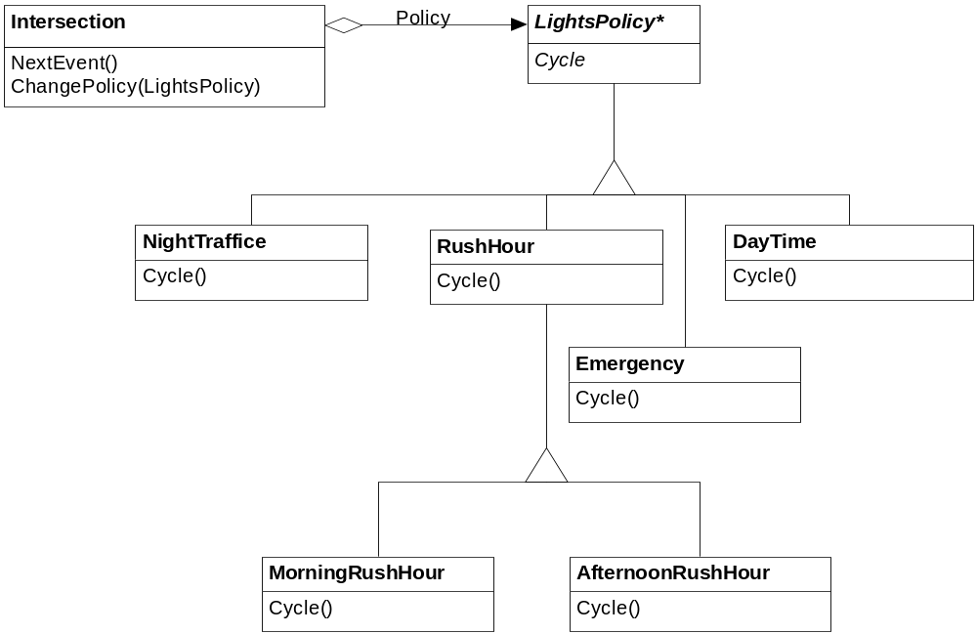
Strategy: Consequences
Easy to factor out similar strategies using inheritance

Slide 31
Inheritance vs. Strategy Solution
Subclassing:
  Mixes the algorithm implementation with context’s, making Context harder to understand, maintain, and extend. Can not vary the algorithm dynamically.
Strategy:
  Vary the algorithm independently of its context, making it easier to switch, understand, and extend.

Slide 32
Trade-offs
Advantages
Eliminates large conditional statements.
Easier to keep track of different behavior because they are in different classes.
A variety of implementations for the same behavior.
Disadvantages
Increases the number of objects.
All algorithms use the same interface.

Slide 33
Summary of Strategy Pattern
Many related classes differ in behavior
Need to use the same algorithm with a slight variation
Hides complex, algorithm-specific data structures from the client
Eliminate conditional branches and put them in their own separate strategy class

Slide 34
Home Work
There are a lot of similarities between state and strategy patterns.
  What is the difference between the two?

Slide 35
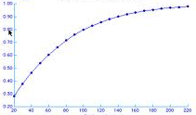
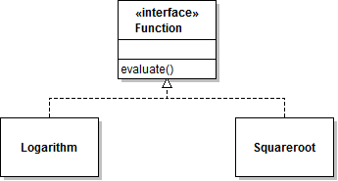
QUIZ
public class Graph {
private Function f = new Logarithm();
public draw()
{ plot(1,f.evaluate(1)); … }
}
public class Graph {
private Function f;
public Graph(Function fun) { f=fun; }
public draw()
{ plot(1,f.evaluate(1)); … }
}
Which versions of Graph class use strategy pattern?
None
A
B
A,B
I don’t know
A
B

Slide 36
Final Example: Design with Strategy
DocumentComponent
Paragraph
Composite
Title, level
NumberingStrategy
NoNumberStrategy
NumberStrategy

Slide 37
Command Pattern

Slide 38
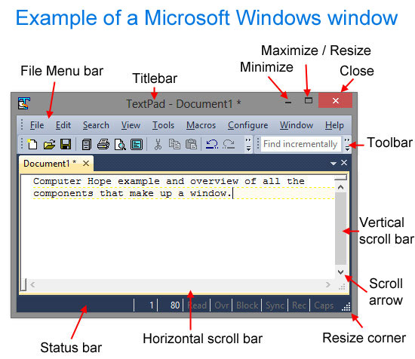
Introduction
Sometimes a class needs to perform actions without knowing what the actions are…
Example:
  A GUI toolkit provides several components: Buttons, scroll bars, text boxes, menus, etc.
Toolkit components only know apriori know how to draw themselves on the screen:
  But they don't know how to perform application logic
Application developers need a way to associate required application logic with GUI components
  What should happen when a button is pressed?
  What should happen when a menu item is selected?

Slide 39
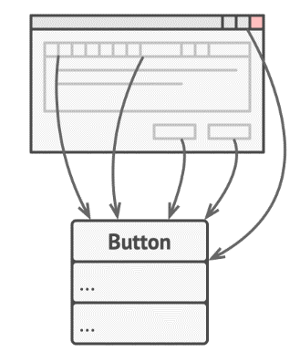
Motivation
Suppose you’re working on a new text-editor app.
You created a very neat Button class:
  To be used as generic buttons in various dialogs.

Slide 40
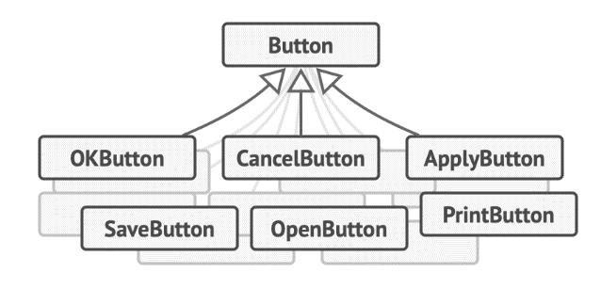
First-Cut Design
But, generic buttons won’t do much:
  But, each button needs to carry out separate actions.
You toyed with the idea of creating hundreds of sub-classes of the button class.

Slide 41
First-Cut Design --- Cons
You have an enormous number of subclasses --- Poses Maintenance issues
You break the design each time you modify a base class
You may have different methods for invoking the same command, e.g hot keys
  Either duplicate code or make hot-keys dependent on buttons

Slide 42
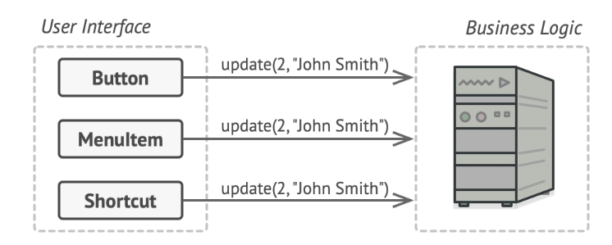
Refined Design
GUI object calls a method of a business logic object, passing it some arguments.

Slide 43
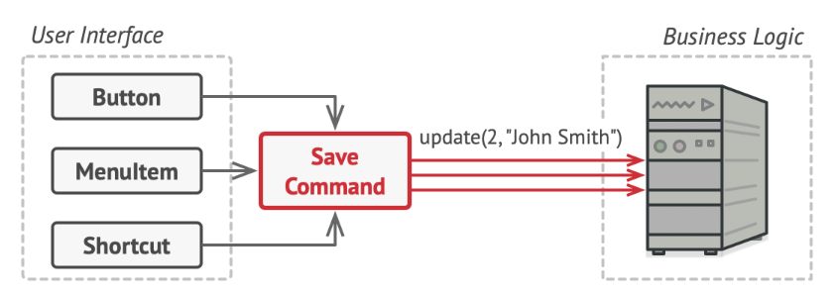
Next Refinement
But, you next recognize that all commands need to implement the same interface…

Slide 44
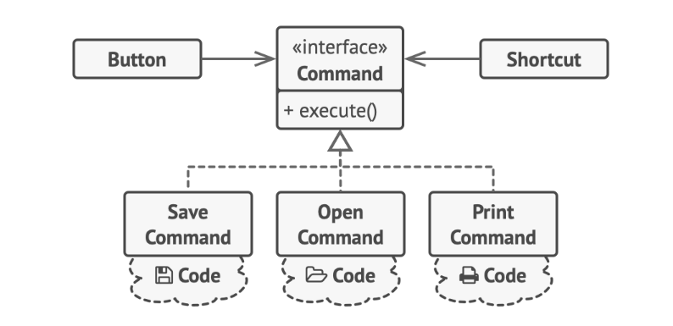
Command Pattern: GUI Objects Delegate Work to Command Objects

Slide 45
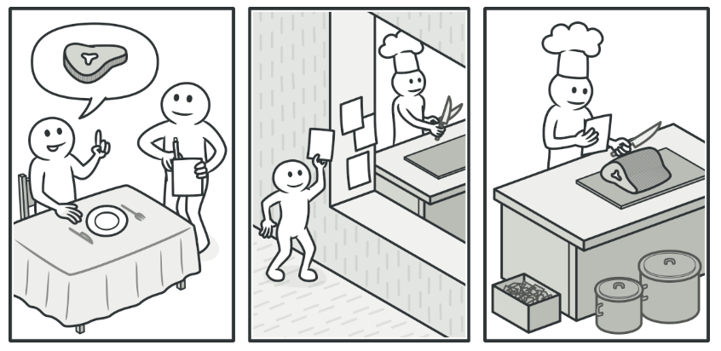
Real World Example

Slide 46
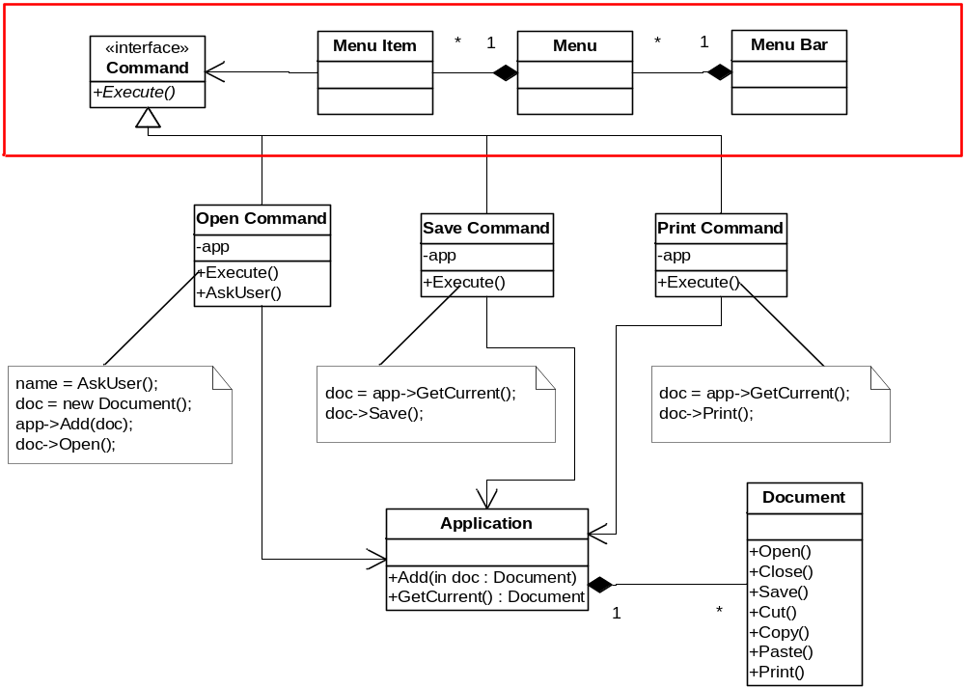
Example: GUI Toolkit

Slide 47
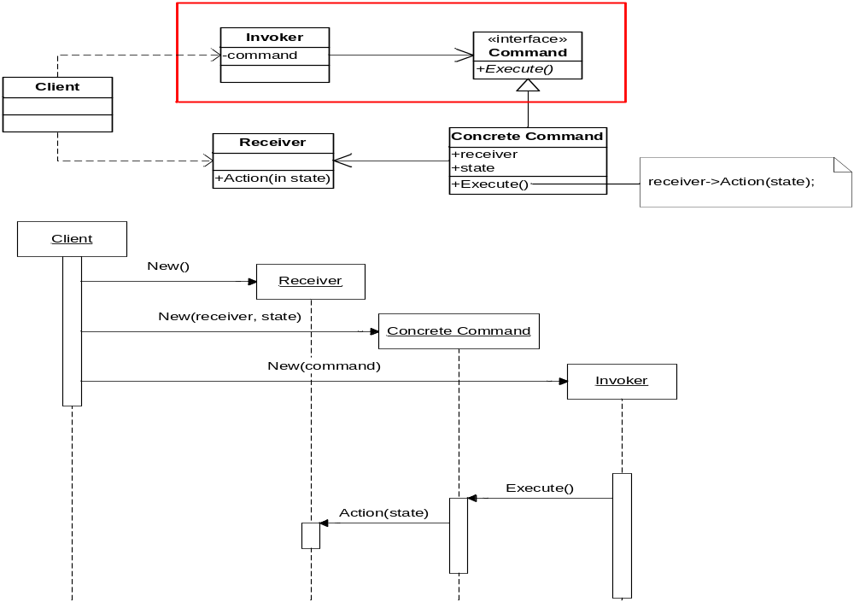
Example: GUI Toolkit

Slide 48
Other Applications of Command
Support Undo:
  It’s difficult to undo effects of an arbitrary method as Methods vary over time.
What are some applications that need to support undo?
  Editor, calculator, database with transactions. etc
Support Redo:
  Similar complex issues

Slide 49
Structure of command pattern
1
Invoker stores commands and asks ConcreteCommand objects to perform action
Client
Invoker
Command
Execute()
1
receiver
Receiver
ConcreteCommand
Action()
Receiver.Action()
execute()
State

Slide 50
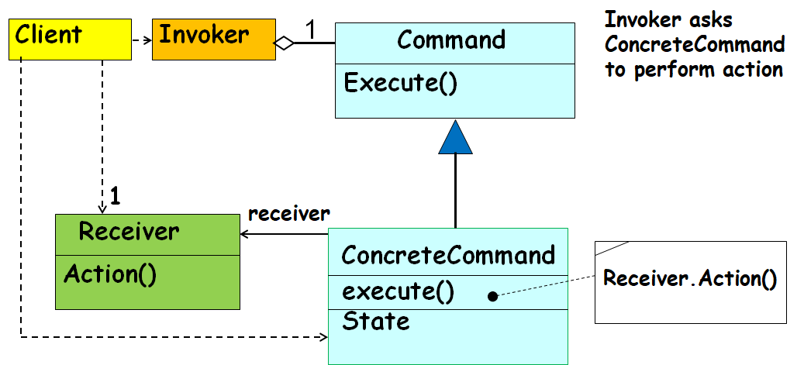
Command pattern: Participants
Command (Command) declares an interface for executing an operation
ConcreteCommand defines a binding between a Receiver object and an action
  implements Execute by invoking the corresponding operation(s) on Receiver
Invoker asks the command to carry out the request
Receiver knows how to perform operations associated with carrying out the request
Client creates a ConcreteCommand object and sets its receiver

Slide 51
Command pattern: Operation
Client creates a ConcreteCommand object and specifies its receiver.
An Invoker object stores the ConcreteCommand object
The invoker issues a request by calling Execute on the command.
When commands are undoable, ConcreteCommand stores state for undoing before invoking Execute
ConcreteCommand object invokes operations on its receiver to carry out request

Slide 52
Sequence Diagram
:aClient
aReceiver
anInvoker
aCommand
<<new >>
<<new >>
<<new>>
StoreCommand(aCommand)
Execute()
Action()

Slide 53
Consequences
Completely decouples objects from the actions they execute
Objects can be parameterized with arbitrary actions
Adding new kinds of actions is easy
  Just create a new class that implements the Command interface

Slide 54
Known Uses: Undo/Redo
Store a list of actions performed by the user
Each action has
  A “do” method that knows how to perform the action
  An “undo” method that knows how to reverse the action
Store a pointer to the most recent action performed by the user
Undo – “undo” the current action and back up the pointer
Redo – move the pointer forward and “redo” the current action

Slide 55
Exercise 1
Assume that you can place on a trading platform (also called a broker) a set of buy ands sell order on specific stocks.
The broker deals with a large number of stocks.
It will place either buy or sell order for specific stocks as you might have specified.

Slide 56
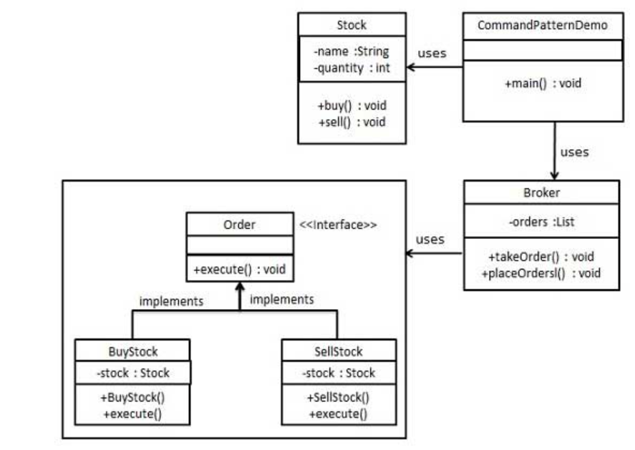
Exercise 1: Solution

Slide 57
Players in the Design
interface Order which is acting as a command.
Stock class acts as a request.
Concrete command classes BuyStock and SellStock implementing Order interface which will do actual command processing.
A class Broker is created which acts as an invoker object.
  It can take and place orders.

Slide 58
Implementation
public interface Order {
void execute();
}
public class Stock { //Receiver
private String name = "ABC";
private int quantity = 10;
public void buy(){
System.out.println("Stock [ Name: "+name+",
Quantity: " + quantity +" ] bought");
}
public void sell(){
System.out.println("Stock [ Name: "+name+",
Quantity: " + quantity +" ] sold");
}
}

Slide 59
public class BuyStock implements Order {
private Stock abcStock;
public BuyStock(Stock abcStock){
this.abcStock = abcStock;
}
public void execute() {
abcStock.buy();
}
}
Public class SellStock implements Order {
private Stock abcStock;
public SellStock(Stock abcStock){
this.abcStock = abcStock;
}
public void execute() {
abcStock.sell();
}
}

Slide 60
import java.util.ArrayList;
import java.util.List;
public class Broker {
private List<Order> orderList = new ArrayList<Order>();
public void takeOrder(Order order){
orderList.add(order);
}
public void placeOrders(){
for (Order order : orderList) {
order.execute();
}
orderList.clear();
}
}

Slide 61
public class CommandPatternDemo {
public static void main(String[] args) {
Stock abcStock = new Stock();
BuyStock buyStockOrder = new BuyStock(abcStock);
SellStock sellStockOrder = new SellStock(abcStock);
Broker broker = new Broker();
broker.takeOrder(buyStockOrder);
broker.takeOrder(sellStockOrder);
broker.placeOrders();
}
}

Slide 62
Exercise
Design and Build a remote that will control variety of home devices
  Add an “undo” button to support one undo operation
Sample devices: lights, stereo, TV, ceiling light, thermostat, sprinkler, hot tub, garden light, ceiling fan, garage door

Slide 63
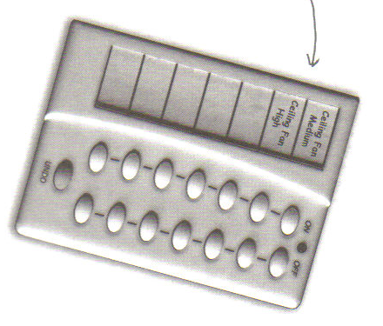
Command pattern – Undo operation

Slide 64
Command Pattern Class Diagram for Home automation
RemoteControl
RemoteLoader
onCommands
offCommands
setCommand()
onButtonPushed()
offButtonPushed()
<<Interface>>
Command
execute()
undo()
Light
LightOnCommand
on()
off()
LightOffCommand
execute()
undo()
execute()
undo()

Slide 65
Public interface Command{
Public void execute();
}
Public class SwitchOnCommand implements Command{
Switch switch;
public LightOnCommand(Switch switch){
this.switch = switch; }
public void execute(){ switch.on(); }
}

Slide 66
Public class RemoteControlTest{
Public static void main(String[] args){
RemoteControl remote=new RemoteControl();
GarageDoor garageDoor = new GarageDoor();
GarageDoorOpenCommand = new
GarageDoorOpenCommand(garageDoor);
remote.setCommand(garageOpen);
remote.buttonPressed();
}
}

Slide 67
Public class RemoteControl{
Command slot;
Public RemoteControl(){}
Public void setCommand(Command command){
slot = command;
}
public void buttonPressed(){
slot.execute();
}
}

Slide 68
Exercise
Macros:
  Record a sequence of user actions so they can be turned into a macro
  Macro can be re-executed on demand by the user

Slide 69
Macro Commands
public class MacroCommand implements Command {
Command[] commands;
public MacroCommand(Command[] commands) { this.commands = commands;
}
public void execute() {
for (int i = 0; i < commands.length; i++) {
commands[i].execute();
}
}
public void undo() {
for (int i = 0; i < commands.length; i++) { commands[i].undo();
}
}
}

Slide 70
Command pattern: Final Analysis
It is easy to add new Commands, because you do not have to change existing classes
  Command is an abstract class, from which you derive new classes
  execute(), undo() and redo() are polymorphic functions
You can undo/redo any Command
  Each Command stores what it needs to restore state
You can store Commands in a stack or queue
  Command processor pattern maintains a history

